Slide 1
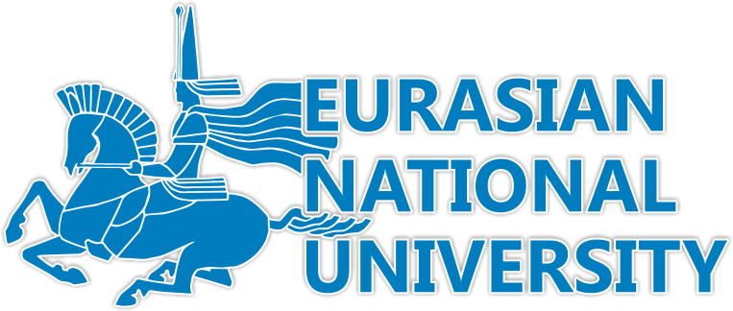
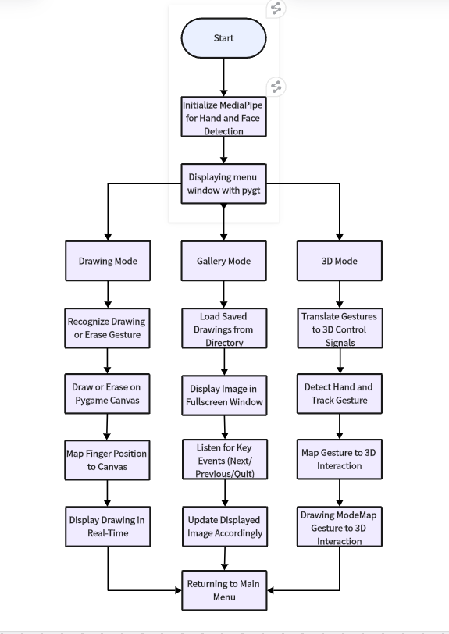
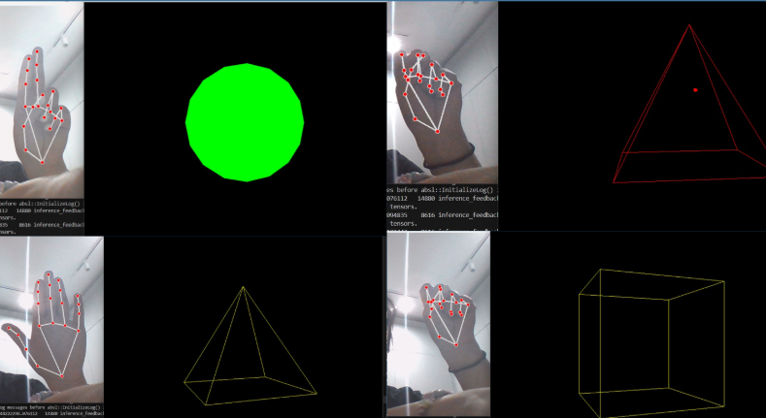
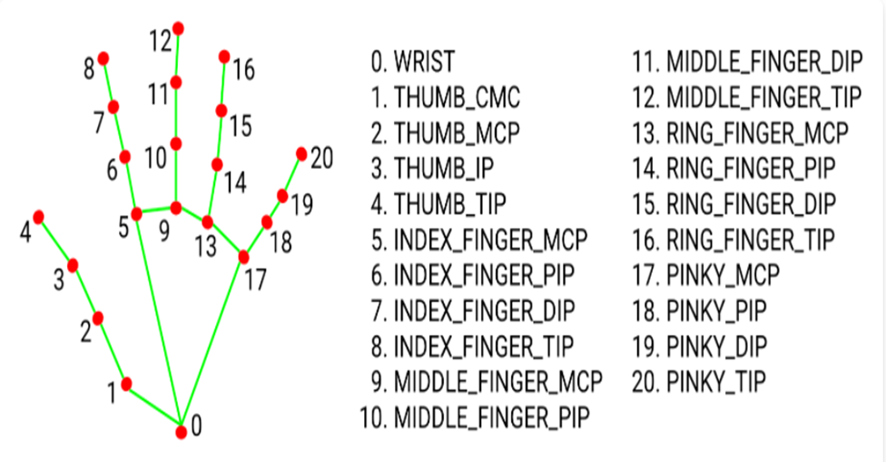
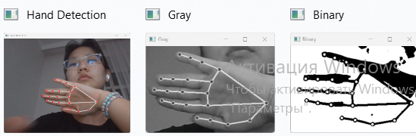
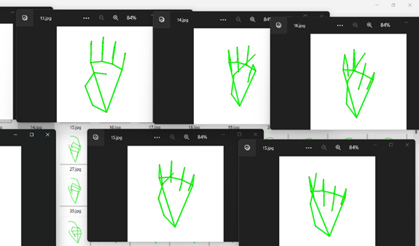
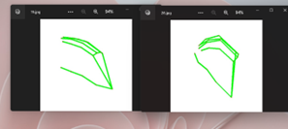
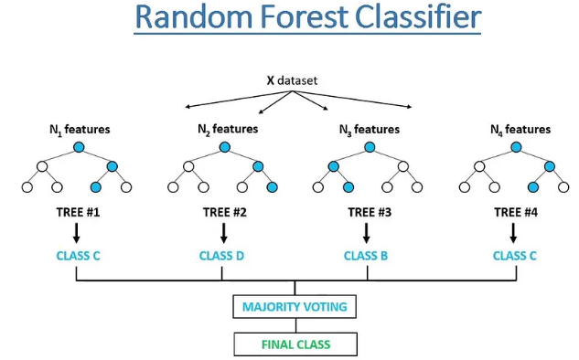
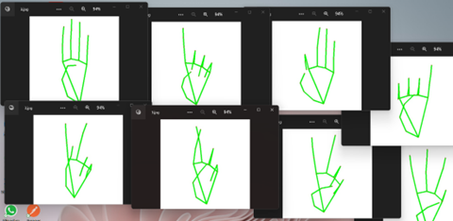
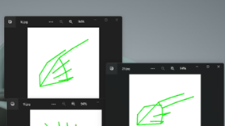
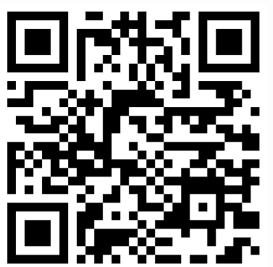
This Scientific Poster on hand gesture recognition
Course project, 3rd year, L.N. Gumilyov Eurasian National University
Authors: Altyn, Aruzhan
Supervisor Zhukabaeva T.K
Abstract
Methodology
Results
Conclusion
The system is built around a PyQt main menu that allows users to choose between three modes: Drawing, Gallery, and 3D. Each mode uses real-time hand tracking via MediaPipe for gesture control.
In Drawing Mode, hand gestures control color, brush size, and drawing actions on a live canvas using Pygame. Saved drawings are stored locally.
Gallery Mode loads saved images and allows navigation through keyboard input in fullscreen view.
3D Mode uses OpenGL to render interactive objects. Gestures are mapped to shape selection, color changes, and spatial drawing.
The final system achieves responsive real-time performance across all three modes:
Drawing Mode detects gestures with over 90% consistency and allows smooth sketching and erasing.
Gallery Mode successfully loads and displays saved images with instant navigation.
3D Mode enables rotation, color control, and object switching using hand signals with stable OpenGL rendering at 30–60 FPS. User testing confirmed intuitive control and ease of use, with minimal delay in gesture recognition and feedback
This project successfully implements a real-time gesture-controlled augmented reality system with an emphasis on modularity, usability, and responsiveness. By fusing computer vision, real-time rendering, and GUI components into a cohesive framework, the system offers a flexible platform for natural user interaction. The use of MediaPipe for landmark detection proves effective for robust hand tracking, while PyOpenGL and Pygame enable low-latency visual feedback in both 2D and 3D spaces.
The gesture-based interface not only eliminates the need for physical controllers but also introduces a more intuitive and accessible form of interaction, particularly valuable in contexts such as education, digital creativity, and physical rehabilitation. The modular architecture allows each mode to operate independently while sharing common input and processing resources, making the system scalable and easily extendable.
Future improvements may include support for multi-hand tracking, gesture-based object transformations (scaling, rotation), and integration with voice commands or cloud-based storage. Overall, this work contributes to the growing field of natural user interfaces by showcasing how gesture-driven AR applications can be made practical, interactive, and user-friendly with accessible technologies.
The integration of gesture recognition into interactive systems presents new opportunities for natural, touchless human-computer interaction, particularly within the context of augmented reality (AR). This project introduces a modular AR application that leverages real-time hand gesture recognition to enable three core functionalities: freehand digital drawing, 3D object manipulation, and image gallery navigation. The system is implemented using Python and combines multiple technologies—MediaPipe for hand and face tracking, OpenCV for video input, PyOpenGL for rendering 3D objects, PyQt for GUI management, and Pygame for drawing and visualization.
Users interact with the system through intuitive hand gestures detected via webcam, eliminating the need for conventional input devices. Drawing Mode allows users to paint in real-time on a virtual canvas using one-finger gestures; Gallery Mode presents stored drawings in fullscreen with keyboard navigation; and 3D Mode enables manipulation of geometric objects in space through tracked gestures. The project demonstrates the feasibility of combining real-time computer vision with graphics rendering to create an immersive AR environment that can serve applications in digital art, education, and rehabilitative therapy.
Introduction
In recent years, the convergence of computer vision, real-time graphics, and user interaction has opened the door to immersive and intuitive digital experiences. One such field at this intersection is Augmented Reality (AR), where the physical and digital worlds merge through live visual overlays and gesture-based control. Traditionally, interaction with digital environments requires physical devices such as a mouse, keyboard, or touchscreen. However, the increasing maturity of gesture recognition technology enables touchless, more natural interfaces.
This project presents a gesture-driven AR application developed using Python. The system utilizes real-time hand and face tracking to offer users an interactive platform with three core functionalities: digital drawing, 3D object manipulation, and image gallery visualization. Each mode is seamlessly accessible through a PyQt-based graphical interface, allowing users to switch between activities without restarting the application or using traditional input tools. The application leverages the MediaPipe framework for precise hand landmark detection, OpenCV for video input and processing, OpenGL for dynamic 3D rendering, and Pygame for canvas manipulation and gallery display. The result is a cohesive and interactive environment that responds to natural hand gestures in real time, creating an engaging user experience that bridges creative expression, education, and spatial computing.
By integrating multiple computer vision and graphics technologies into a modular, gesture-controlled system, this project demonstrates the practical potential of AR applications outside of entertainment — particularly in fields like digital art, virtual classrooms, and rehabilitation therapy.
MediaPipe was used to detect 21 hand landmarks, extracting (x, y) coordinates as feature vectors.
Once a hand is identified, the region of interest (ROI) is extracted, cropped, and converted to grayscale using OpenCV for further processing.
Acknowledgements
The authors express their gratitude to Eurasian National University for providing the resources and academic guidance necessary for this research. Special thanks to our supervisor Zhukabaeva T.K. for their valuable insights and continuous support throughout the project.
Additionally, we acknowledge the contributions of the MediaPipe and OpenCV development teams for their open-source libraries, which were instrumental in the implementation of hand detection and image processing.
Finally, we appreciate the support of our colleagues, friends, and family, whose encouragement and feedback played a crucial role in the successful completion of this project.
A Random Forest classifier was trained on the extracted features.The trained model was saved as model.p for later use.
appreciate the support of our colleagues, friends, and family, whose encouragem
📧 Email: aruzanbekenova764@
gmail.com altynzhomartovna@gmail.com

